Slide 1

Comprehensive Digital Marketing
Project Work For HAVELLS

Slide 2

Part 1: Brand study, Competitor Analysis & Buyer’s/Audience’s Persona
COMPANY/TOPIC for project: Havells India Ltd.
Research Brand Identity: Study the brand's mission, values, vision, and unique selling propositions (USPs).
LOGO:
Brand colours: Red & White
Tagline: Committed to save energy
Mission/Values:Havells India Ltd Mission and values is business ethics, global reach, technological expertise, building long-term relationships with all our associates, customers, partners and employees.
USP:The unique selling proposition of Havells revolves around energy efficiency and cost-effectiveness.

Slide 3
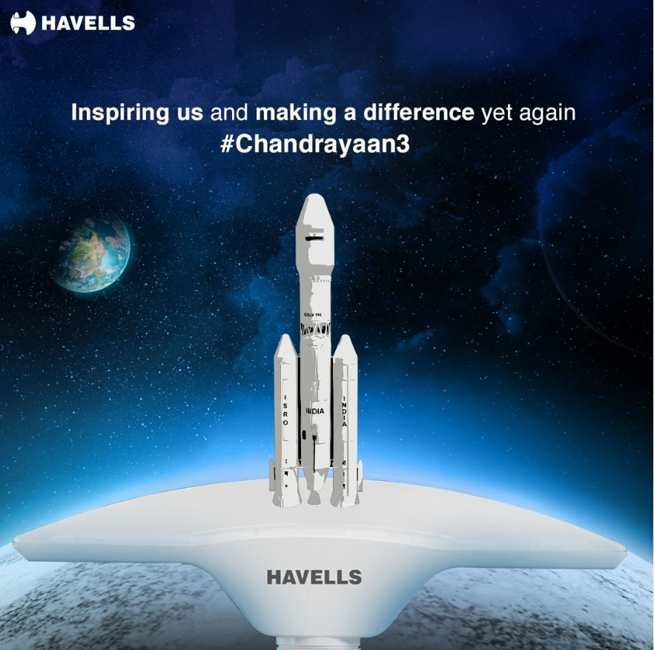

Part 1: Brand study, Competitor Analysis & Buyer’s/Audience’s Persona
Analyze Brand Messaging: Innovation and Technology & creative
Havells India Ltd. is all about being innovative. They offer reliable electrical solutions that customers can trust. They care about energy efficiency and sustainability, aiming for a greener future. Havells wants to connect with people's emotions and make a positive impact. In short, Havells' brand message can be summed up in one word: innovation.
https://www.instagram.com/p/Cur1ASRJJTG/?hl=en
https://www.instagram.com/p/CuHOZK1oyi3/?hl=en
Examine the brand's tagline: Committed to save energy
Havells India Ltd. is committed to saving energy and being environmentally responsible. They prioritize sustainability by focusing on energy conservation. By promoting eco-friendly practices, Havells appeals to customers who value protecting the environment and conserving resources.

Slide 4
Part 1: Brand study, Competitor Analysis & Buyer’s/Audience’s Persona
Competitor Analysis: Select three competitors operating in the same industry or niche as the chosen brand, examine their USPs and online communication.
Competitor 1:
USP: Wide variety of products, Corporate Social Responsibility
Communication:Clear and Responsive Customer Support
Competitor 2:https://www.cgglobal.com/
USP: Global Reach and Adaptability, Innovative Solutions, Reliability and Quality
Communication:Customer Feedback and Reviews
Competitor 3:https://www.exideindustries.com/
USP: Extensive Product Range, Nationwide Network and ServiceCustomer-Centric Approach
Communication:Transparency and Clear Communication
https://www.bajajelectricals.com/

Slide 5
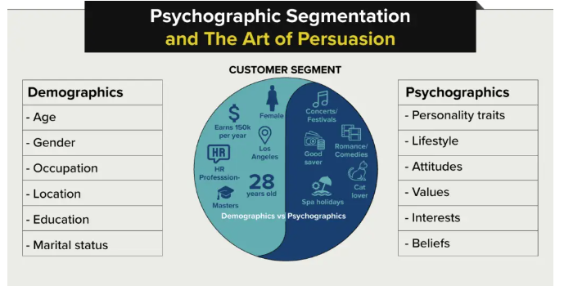
Part 1: Brand study, Competitor Analysis & Buyer’s/Audience’s Persona
Buyer's/Audience's Persona: Clearly define the target audience for the chosen brand. Consider demographics, psychographics, behaviors, and interests.
Havells Company can focus on promoting the quality, reliability, and innovative features of their products.
Target Audience for Havells Company: Tech-savvy professionals seeking quality, innovative, and energy-efficient electrical solutions for their homes.
Demographic - Urban professionals (age 25-40, both genders) with above-average income.
Psychographic - Tech-savvy individuals who value quality, innovation, and energy efficiency in their electrical solutions.

Slide 6
Part 2: SEO & Keyword Research
SEO Audit: Do an SEO audit of the brands website
Keyword Research: Define Research Objectives, Brainstorm Seed Keywords, Utilize Keyword Research Tools (SEMrush or Moz Keyword Explorer),Analyze Competitor Keywords, Long-tail Keyword Exploration (specific, longer phrases) that align with the research objectives and have lower competition but higher conversion potential.
On page Optimization: Meta Tag optimization & content optimization
Reflect on the process of conducting keyword research and the SEO recommendations provided.
Document the challenges faced during the research and analysis phase, as well as the key insights gained from the keyword research process.

Slide 7
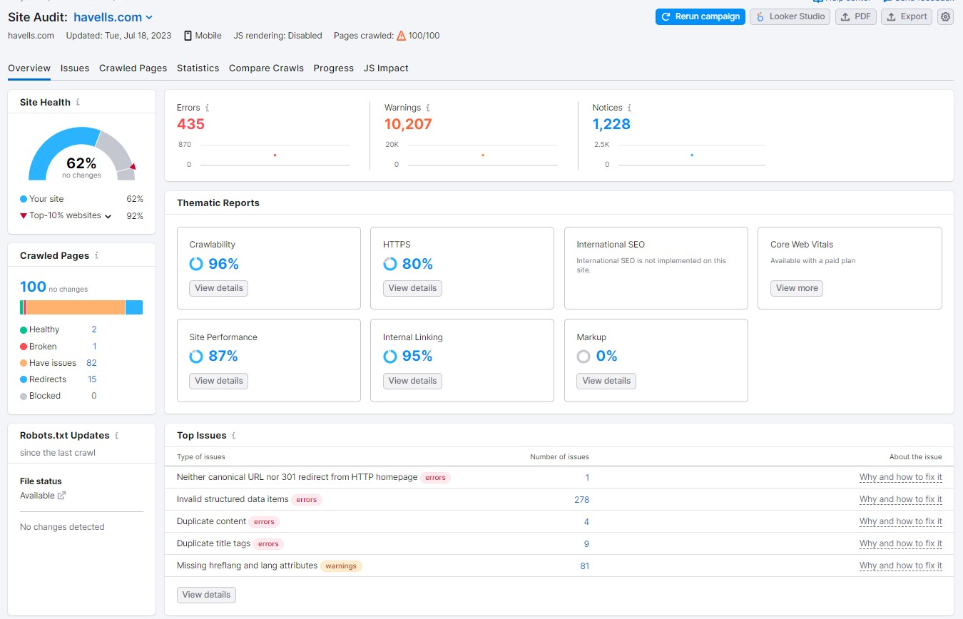
SEO Audit

Slide 8
Research Objectives "To conduct a comprehensive market analysis and consumer research to gain insights into the evolving electrical appliances and consumer electronics industry in India. The research aims to identify emerging trends, understand customer preferences, and assess the competitive landscape. The findings will help Havells India Ltd to strategically position its product offerings, develop innovative solutions, and strengthen its market presence while maintaining customer satisfaction and brand loyalty
Long Tail Keywords
Long Tail Keywords
"Havells ceiling fans for large rooms"
"Havells energy-efficient LED bulbs"
"Best Havells water heaters under 6000"
"Havells smart switches for home automation"
"Havells premium decorative lights"
"Havells kitchen appliances for small spaces"
"Havells high-speed pedestal fans"
"Review of Havells RO water purifiers"
"Havells inverter ACs for coastal areas"

Slide 9
Seed Keywords
Seed Keywords
Havells products
Havells electrical appliances
Havells fans
Havells lights
Havells switches
Havells LED bulbs
Havells water heaters
Havells air purifiers
Havells kitchen appliances
Havells air conditioners
Havells exhaust fans
Havells smart home products
Havells electrical accessories

Slide 10
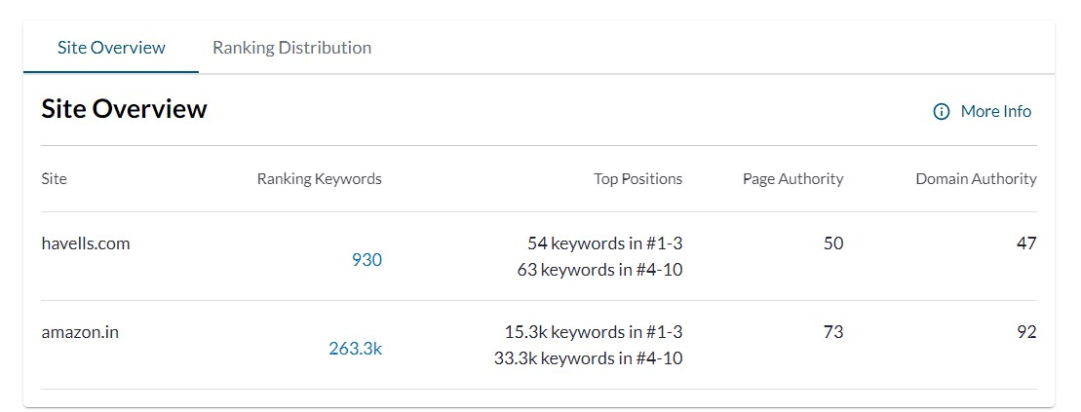
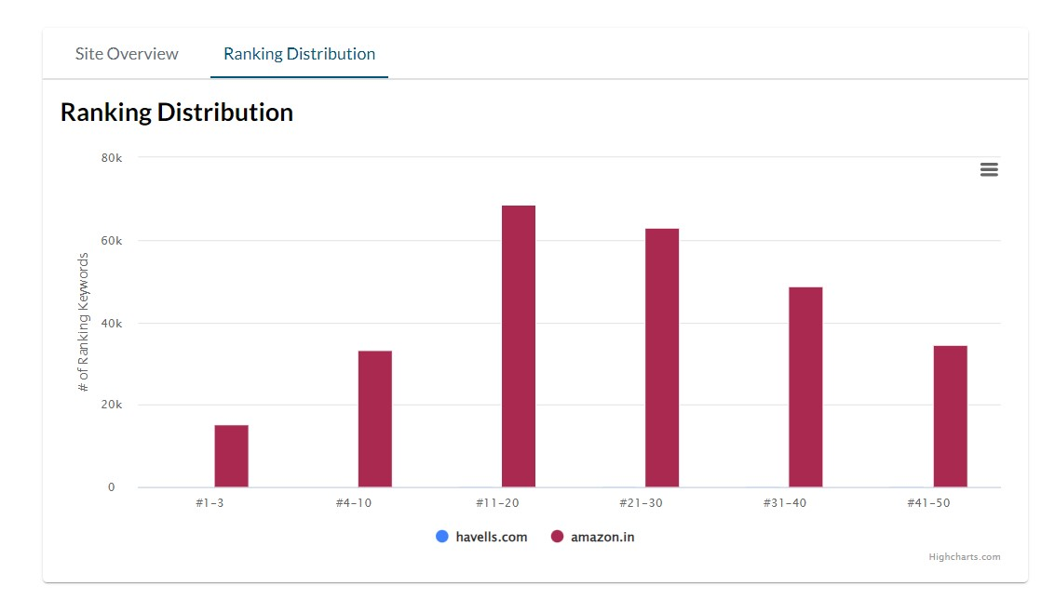
Analyze Competitor Keywords

Slide 11
Meta Tag Optimization for www.havells.com:
Title Tag:- Current Title Tag: "Havells India - Fans, Home & Kitchen Appliances, LED Lights, Personal Grooming“
Suggested Title Tag: "Havells India - Leading Brand for Fans, Home Appliances, LED Lights, and Personal Grooming“
2. Description Tag:- Current Description Tag: "Rediscover the joy of fresh living & eating with Havells Domestic Appliances such as electric iron, food processors, juicer mixer grinders, induction cooker, room heaters etc.“
Suggested Description Tag: "Discover a fresh living experience with Havells Domestic Appliances - Electric Irons, Food Processors, Juicer Mixer Grinders, Induction Cookers, Room Heaters, and more.“
3. Keywords Tag: Suggested Keywords Tag: "Havells India, Fans, Home Appliances, LED Lights, Personal Grooming, Electric Iron, Food Processor, Juicer Mixer Grinder, Induction Cooker, Room Heaters.“
Content Optimization for www.havells.com:
1. Homepage:- Ensure the homepage showcases a visually appealing layout with clear navigation for easy access to different product categories.Add a prominent call-to-action (CTA) above the fold to encourage visitors to explore products or shop now.

Slide 12
2. Product Pages:- Each product page should have a unique and descriptive title that includes the product name and key features. Provide comprehensive product descriptions that highlight the product's benefits, features, and specifications
3. Blog:- Create and maintain a blog section to share informative articles related to home appliances, health, wellness, and lifestyle.Optimize blog posts with relevant keywords to improve organic search visibility
4. About Us Page:- Provide a compelling and concise "About Us" section, showcasing Havells' brand history, mission, and commitment to quality.Include information about the company's values, sustainability initiatives, and social responsibility efforts.
5. Contact Page:- Ensure the contact page contains a user-friendly form for inquiries and feedback.Include essential contact details, such as a phone number, email address, and physical address.
6. SEO Best Practices:- Regularly update the website with fresh content, new product releases, and promotions to keep it relevant and rank higher in search engine results. Optimize images with alt tags for improved accessibility and search engine crawls. Focus on link building and outreach to improve domain authority and search rankings.

Slide 13
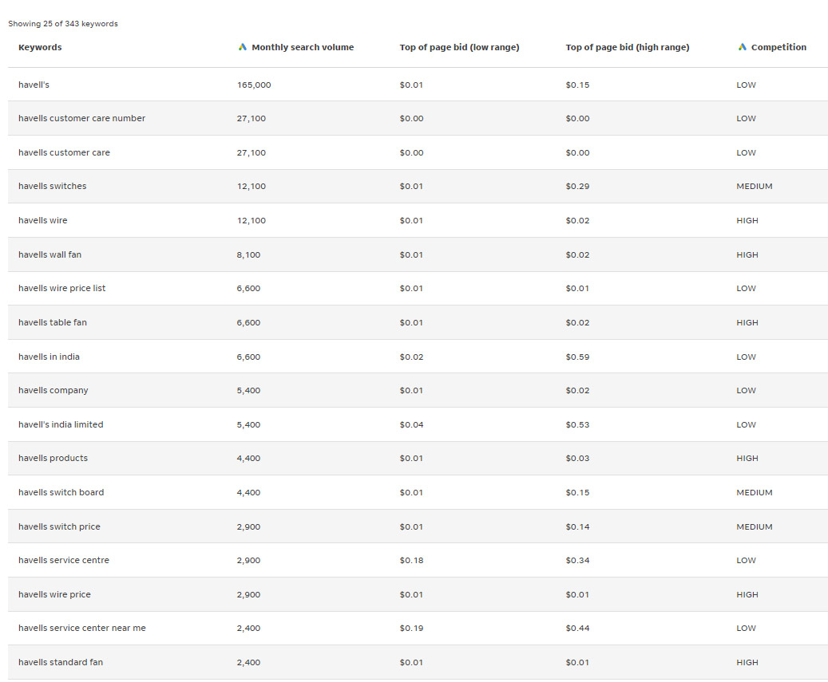
Keyword research of havells
Top keywords : CONSUMER CONSUMER. FANS. LIGHTING. APPLIANCES. WATER HEATER. AIR COOLER. WATER PURIFIER. PERSONAL GROOMING. LLOYD CONSUMER DURABLE. PUMP. SWITCHES. SWITCHGEAR. FLEXIBLE CABLES.
Virtual Tour.
Main keywords
https://havells.com/
1. havells products
2.havells electrical appliances
3.havells fans
4.havells home appliances
5.havells LED lights
6.havells energy efficient products
7.havells consumer electronics
8.havells smart home solutions
9.havells industrial products
10.havells cables and wires
11. havells lights
12.havells switches
13. havells wire price
14.havells kitchen appliances
15.havells power distribution solutions
16. havells water heaters
17. havells Standard fan
18.havells electric irons
19. havells air conditioners
20. havells ceiling fans

Slide 14
Part 3: Content Ideas and Marketing Strategies
Content Idea Generation & Strategy: Create a content calendar for the remaining month of July by brainstorming content themes, exploring various formats like blog posts, videos, infographics, podcasts, and interactive quizzes, and scheduling publication dates mainly on Facebook & Instagram. And include the strategy, aim and the idea behind these posts and story
Content Calendar Example (Try creating a table for the month of July)

Slide 15
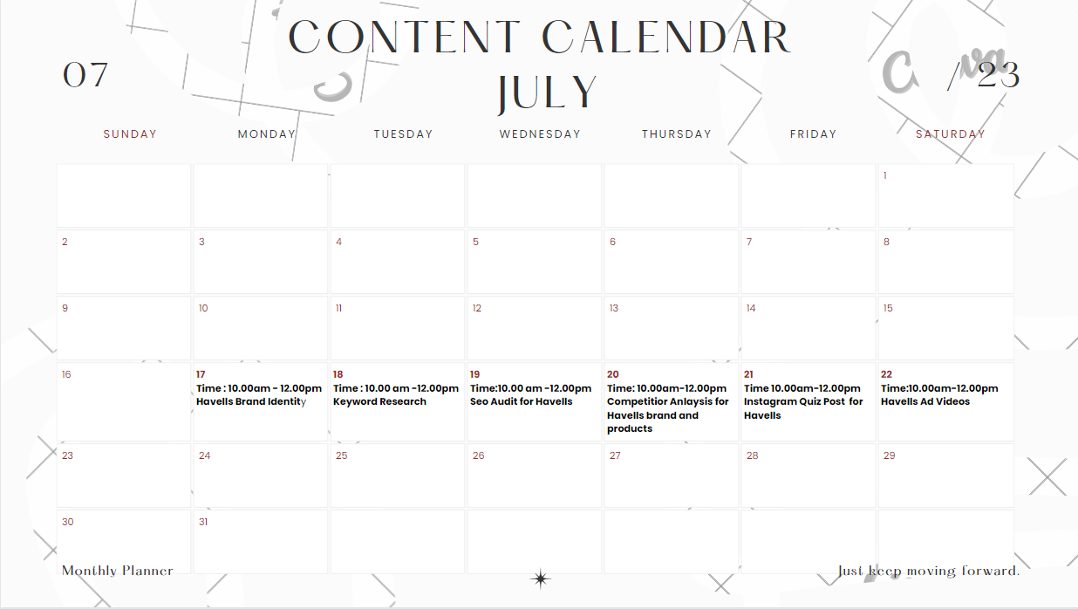
content calendar for month of july

Slide 16
Part 3: Content Ideas and Marketing Strategies
Reflect on the content ideas and marketing strategies process, discussing the challenges encountered and lessons learned.

Slide 17
Aim : Havells, a leading consumer electricals and appliances company, aims to be a pioneer in the industry by continuously innovating and offering high-quality products that enrich the lives of its customers. The company's core focus is to provide sustainable solutions, enhance convenience, and create a safer and smarter living environment for individuals and families alike.
Idea : Havells strives to create a diverse and dynamic product portfolio, offering a wide range of electrical products, home appliances, and smart solutions that cater to the evolving needs of its customers. With a focus on quality, reliability, and energy efficiency, Havells aims to enhance convenience, comfort, and safety in the lives of people across the globe.
Strategy : Havells adopts a multi-faceted and dynamic strategy to maintain its position as a leading player in the electrical and consumer appliances industry. The company's core strategy revolves around innovation, customer-centricity, market expansion, and sustainability.

Slide 18
Part 3: Content Ideas and Marketing Strategies
Reflect on the content ideas and marketing strategies process, discussing the challenges encountered and lessons learned.
Content Ideas and Marketing Strategy Process:
Understanding the Audience: The process begins with in-depth research to understand the target audience's preferences, pain points, and aspirations. This helps in tailoring content that resonates with their needs and interests.
Creativity and Innovation: Developing unique and creative content ideas that stand out in a saturated market is essential. It involves brainstorming sessions, collaboration among team members, and staying updated with current trends.

Slide 19
Brand Identity and Storytelling : Crafting a compelling brand story and identity is crucial for building an emotional connection with customers. Storytelling helps humanize the brand and makes it more relatable.
Multi-channel Approach : Implementing a multi-channel marketing approach ensures that the content reaches a broader audience. This includes leveraging social media, blogs, email marketing, videos, and more.
Challenges Encountered:
Content Overload : In a digital world, consumers are bombarded with content daily. Standing out and capturing their attention amid the content overload can be challenging.
Audience Fragmentation : Different audience segments have diverse preferences, making it difficult to create one-size-fits-all content. Personalization becomes crucial but requires more resources and effort.

Slide 20
Content Quality vs. Quantity : Balancing the need for consistent content production with maintaining high-quality standards can be a challenge.
Platform Algorithm Changes: Social media platforms often update their algorithms, affecting content reach and engagement. Staying adaptable to these changes is vital for success.
Lessons Learned:
Quality Over Quantity: Focus on producing high-quality content that adds value to the audience. Engaging and valuable content tends to have a more significant impact.
Customer-Centric Approach: Put the audience at the core of content creation and marketing strategies. Understanding their needs and preferences leads to more meaningful connections.
Consistency and Patience: Building a strong brand presence and loyal customer base takes time. Consistent efforts and patience are necessary for long-term success.
Agility and Flexibility : Embrace a flexible approach to adapt quickly to changing market trends and platform algorithm updates. This requires ongoing monitoring and evaluation.

Slide 21
Part 4: Content Creation and Curation (Post creations, Designs/Video Editing, Ad Campaigns over Social Media and Email Ideation and Creation)
Post Creation:
Select Content Categories: Identify three different content formats relevant to the chosen topic or industry. Research and Brainstorm: Research trending topics, industry news, or audience interests within each category. Brainstorm ideas for social media posts that align with each category. Do note that 1 content format has to be video and additionally 3 stories/status are to be created.
Format 1:Blog article
Format 2:Video
Format 3:Creative

Slide 22
Part 4: Content Creation and Curation (Post creations, Designs/Video Editing, Ad Campaigns over Social Media and Email Ideation and Creation)
Format 1: Blog article
Blog Link : https://havells--products.blogspot.com
Aim : Boost SEO & provide information about major power distribution equipment manufacturer with a
strong global presence
Date : 20th july 2023
Idea : Havells India introduces innovative Solid State Circuit Breaker (SSCB) technology in
association with Swedish Tech Start Up - Blixt
Topic : 5 ways to use SSCB (Solid State Circuit Breaker) has various applications

Slide 23
Part 4: Content Creation and Curation (Post creations, Designs/Video Editing, Ad Campaigns over Social Media and Email Ideation and Creation)
Format 2 : Video
Aim : To promote a better Summer Havells Fans
Date : 21th july 2023
Idea : Presenting the wide range of Havells Fans, the ultimate summer essential for your home.
Topic : Launch wide range of Havells Fans
Link : https://youtu.be/cJgcU9vFM_E

Slide 24
Part 4: Content Creation and Curation (Post creations, Designs/Video Editing, Ad Campaigns over Social Media and Email Ideation and Creation)
Format 3 : Creative
Aim : Innovation & Technology and Brand awareness
Date : 22th july 2023
Idea : To create an inspiring & trending topic:Chandrayan-3
Post : Chandrayan-3

Slide 25
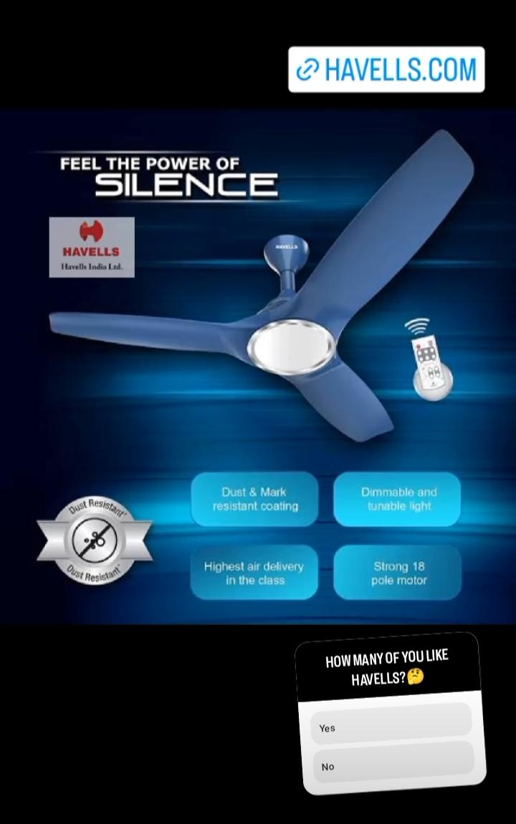
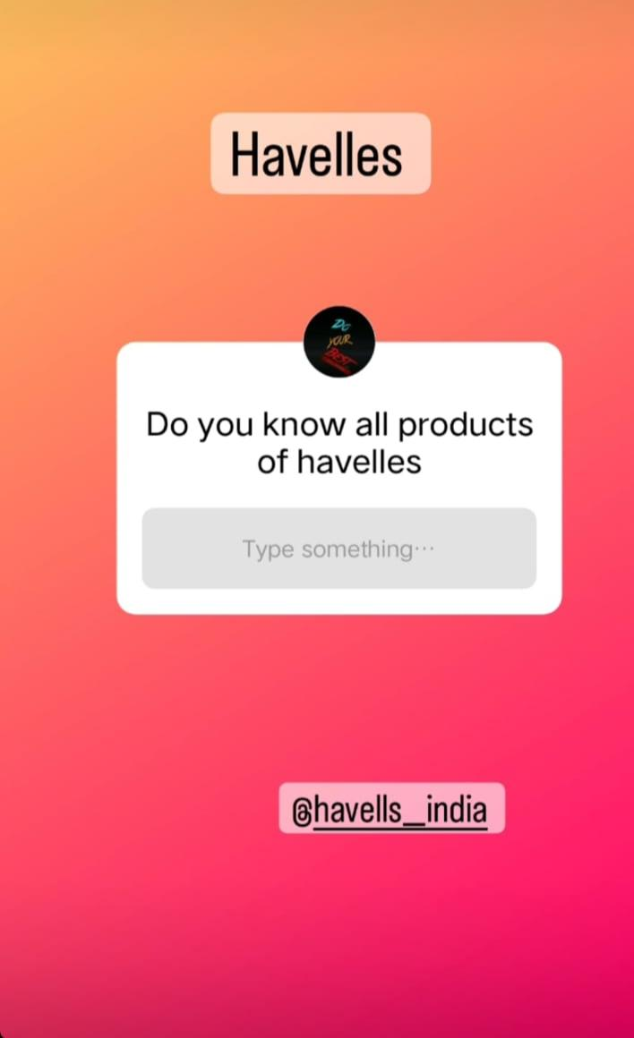
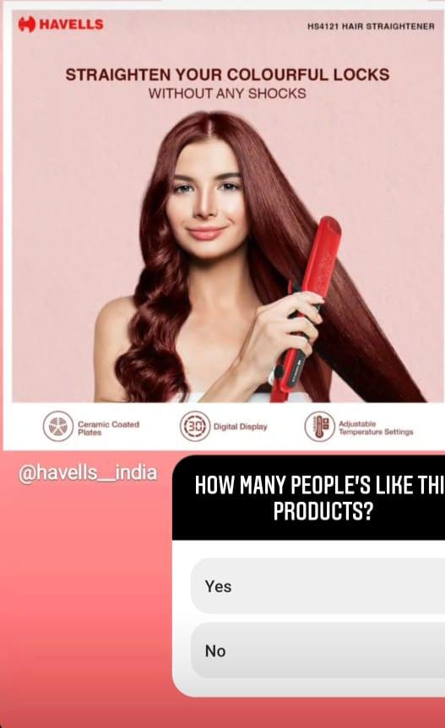
Part 4: Content Creation and Curation (Post creations, Designs/Video Editing, Ad Campaigns over Social Media and Email Ideation and Creation)
Instagram Story

Slide 26
Part 4: Content Creation and Curation (Post creations, Designs/Video Editing, Ad Campaigns over Social Media and Email Ideation and Creation)
Designs/Video Editing
Design Tools Familiarization (use Canva for creating visually appealing graphics)
Video Creation: Utilize VN or any video editor of your choice to create videos related to the chosen topic.
Video link:https://drive.google.com/file/d/1Ro5GspJNRaBPWFLcu4NBXQamKywJimwa/view?usp=sharing
Click on the link above; here, we can find a video ad on Havells created using the Inshots application.

Slide 27

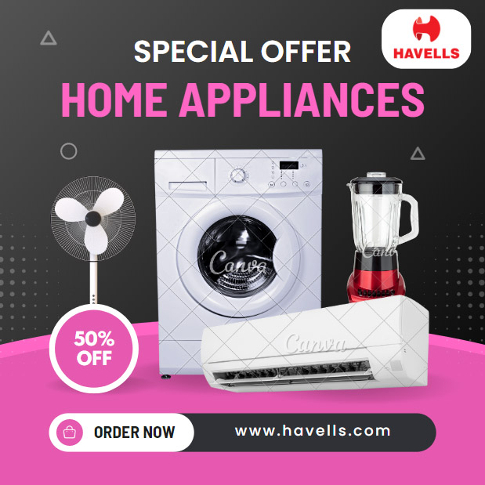
Poster Designs using Canva

Slide 28
Part 4: Content Creation and Curation (Post creations, Designs/Video Editing, Ad Campaigns over Social Media and Email Ideation and Creation)
Social Media Ad Campaigns
Ad Campaigns over Social Media:
Come up with 3 ad campaigns each covering one of the mentioned goals: brand awareness, driving website traffic, or generating leads

Slide 29
Part 4: Content Creation and Curation (Post creations, Designs/Video Editing, Ad Campaigns over Social Media and Email Ideation and Creation)
For every campaign clearly define:
Advertising Goals: increasing brand awareness, driving website traffic, or generating leads.
Audience Targeting: Define the target audience for the ad campaigns based on demographics, interests, and behavior.
Ad Creation: Create visually appealing ad creatives, compelling ad copy and relevant call-to-action.

Slide 30
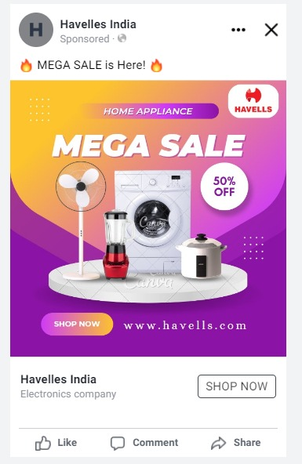
Part 4: Content Creation and Curation (Post creations, Designs/Video Editing, Ad Campaigns over Social Media and Email Ideation and Creation)
Ad Campaign1:Brand Awarness
"Havells Innovations" Video Series (Facebook & Instagram):
Strategy: Showcase the company's latest innovative products and technologies.
Aim: Demonstrate Havells' commitment to innovation and cutting-edge solutions.
Idea: Create a series of short, engaging videos highlighting the unique features and benefits of Havells' latest products like smart home devices, energy-efficient appliances, and industrial solutions.
"Havells Heroes" Customer Testimonials (Instagram Stories & Highlights):
Strategy: Humanize the brand by featuring real stories from satisfied customers.
Aim: Build trust and credibility by sharing positive experiences from customers.

Slide 31
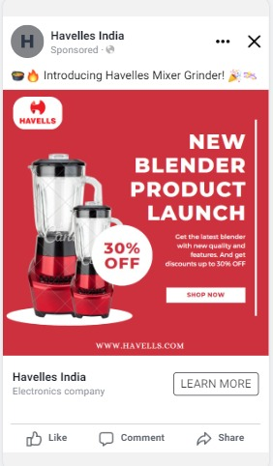
Part 4: Content Creation and Curation (Post creations, Designs/Video Editing, Ad Campaigns over Social Media and Email Ideation and Creation)
Ad Campaign2:Website Traffic
"Product Spotlight" Blog Series:
Strategy: Highlight different products each week to attract potential buyers.
Aim: Showcase the range of products offered by Havells and their unique features.
Idea: Publish weekly blog posts focusing on individual products, their benefits, and how they address specific customer needs.
"Expert Insights" Video Interviews:
Strategy: Position Havells as an industry leader with expert knowledge.
Aim: Engage the audience with valuable insights from industry experts.
Idea: Conduct video interviews with Havells' product experts or industry specialists discussing industry trends, technological advancements, and energy efficiency.

Slide 32
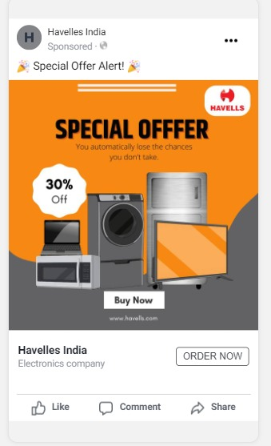
Part 4: Content Creation and Curation (Post creations, Designs/Video Editing, Ad Campaigns over Social Media and Email Ideation and Creation)
Ad Campaign3: Generating leads
"Free Product Demos" Landing Page:
Strategy: Offer free product demonstrations to showcase Havells' offerings.
Aim: Provide potential customers with a hands-on experience of Havells' products.
Idea: Create a dedicated landing page where visitors can sign up for a free product demo session. Highlight the benefits of the demo and the value it offers to businesses and consumers.
"Exclusive Offers" Email Campaign:
Strategy: Provide exclusive deals and discounts to incentivize lead generation.
Aim: Encourage potential customers to take action and submit their details.

Slide 33
Part 4: Content Creation and Curation (Post creations, Designs/Video Editing, Ad Campaigns over Social Media and Email Ideation and Creation)
Email Ad Campaigns
Ad Campaigns for email marketing:
Brand Awareness: Brand awareness refers to the extent to which consumers recognize and recall a particular brand. It is a crucial marketing metric that reflects the brand's visibility, familiarity, and recall among the target audience. Building strong brand awareness helps increase customer trust, loyalty, and preference for the brand's products or services.
Lead generation: Lead generation is the process of attracting and capturing potential customers (leads) who show interest in a company's products or services. It involves various marketing strategies, such as content marketing, social media, and email campaigns, to generate interest and collect contact information for follow-up and conversion into paying customers.

Slide 34
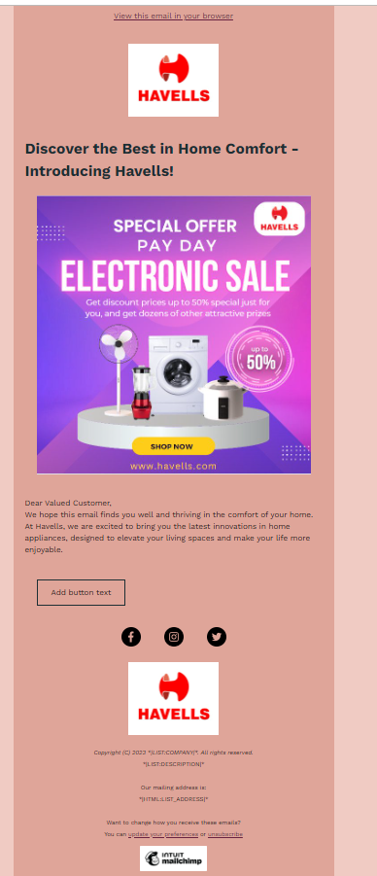
Email Ad Campaign 1 - Brand Awareness
(insert emailer image)

Slide 35
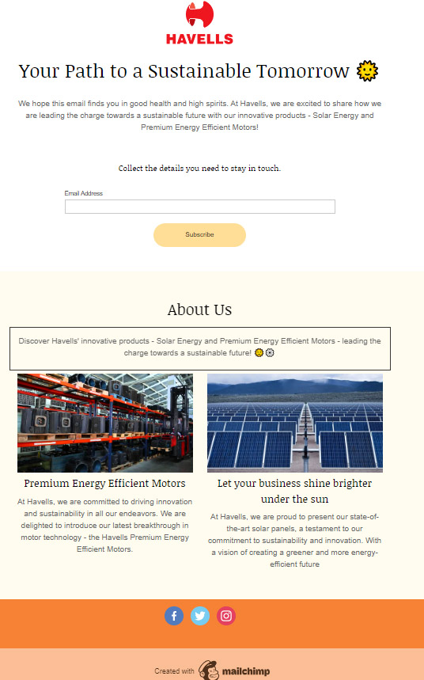
Email Ad Campaign 2 - Lead Generation
(insert emailer image)

Slide 36
Part 4: Content Creation and Curation (Post creations, Designs/Video
Editing, Ad Campaigns over Social Media and Email Ideation and Creation)
Reflect on the content creation and curation process, discussing the challenges faced and lessons learned.
Benefits of content curation include:
Helping to establish an individual or brand as a thought leader in a particular industry or topic.
Providing a valuable resource for a specific audience.
Saving time by efficiently finding and organizing relevant content.
Challenges of content curation include:
Keeping up with the constant flow of new content.
Ensuring that the curated content is accurate, unbiased and appropriate for the intended audience.
Facing legal issues if the curated content includes copyrighted material.

